Slide 1


ML-Ware'22
Counting stained cells from microscopic imagery
By
Srikar Verma
Kaggle ID - jarvis

Slide 2
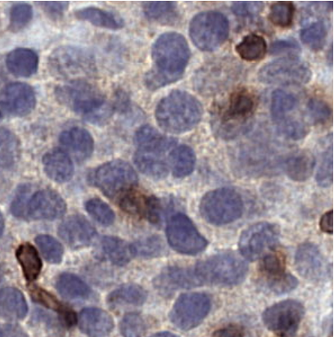
Problem Statement
Count the number of stained cells with a blue nucleus and a brown membrane, in the given miroscopic images.

Slide 3
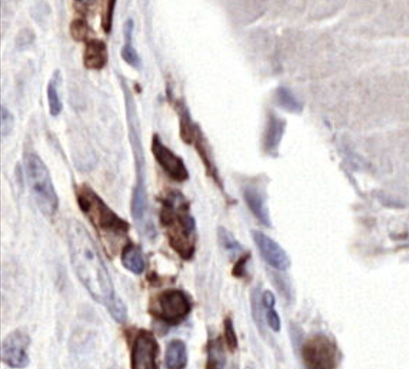
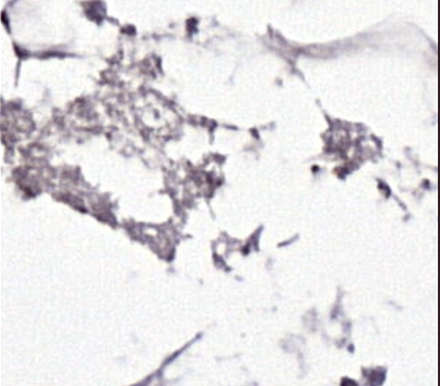
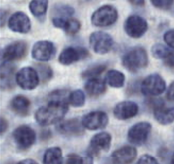
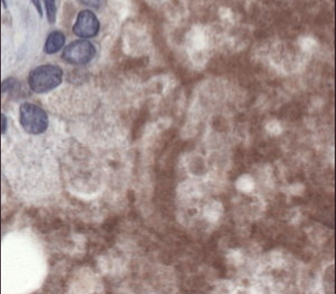
04
Exploring the data

Slide 4
Data and Preprocessing
Training data :
13,400 microscopic images - size 299x299x3
Labels - number of stained cells with blue nucleus and brown membrane.
Image preprocessing:
Pixel values normalized in the range (0,1)
A border of 16 pixels cropped.
Notes:
As our task required counting specific cells from microscopic images, a deep CNN architecture was required, which could accurately map images to cell count.

Slide 5
Potential Solutions
Machine Learning Pipeline
Detection or Segmentation
Using CNNs for Regression
A pipeline made up of a feature extraction method, and a regression method.
However, combining these might be a complex task, and we can also use a single deep learning pipeline as an alternative.
Segmentation/Detection models cannot be trained due to lack of annotated data.
Also, these models would perform poorly in counting cells in a high cell density region.
We could use Convolutional Network architectures, and modify them for regression tasks, so that it could learn a mapping from image input to a numeric output, denoting the number of cells.

Slide 6
Finalizing the Approach
To develop a cell counter, the problem is considered to be a regression task, where we are interested in learning the relationship between image representations and the number of cells.
We may use a Convolutional Neural Network (CNN) that directly predicts the number of cells, i.e., a regression model.
CNN
3

Slide 7
Building the Regression Model

Slide 8
Selecting the Model
As our task required counting specific cells from microscopic images, a deep CNN architecture can be used, which could accurately map images to cell count.
ResNets are powerful CNN-based classification models, which can accurately classify upto 1000 classes of objects.
The ResNet model architecture was selected, due to relatively simple architecture, and the use of skip connections in its layers which significantly improves accuracy.
After trying different variants of ResNet, including ResNet-18, ResNet-34, and ResNet-50, ResNet-34 performed best amongst them, and was thus finalized.
Notes:
As our task required counting specific cells from microscopic images, a deep CNN architecture was required, which could accurately map images to cell count.

Slide 9
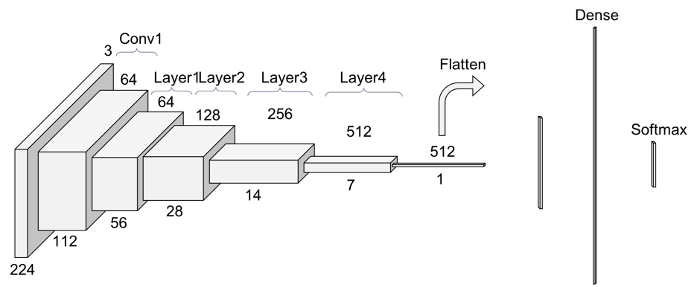
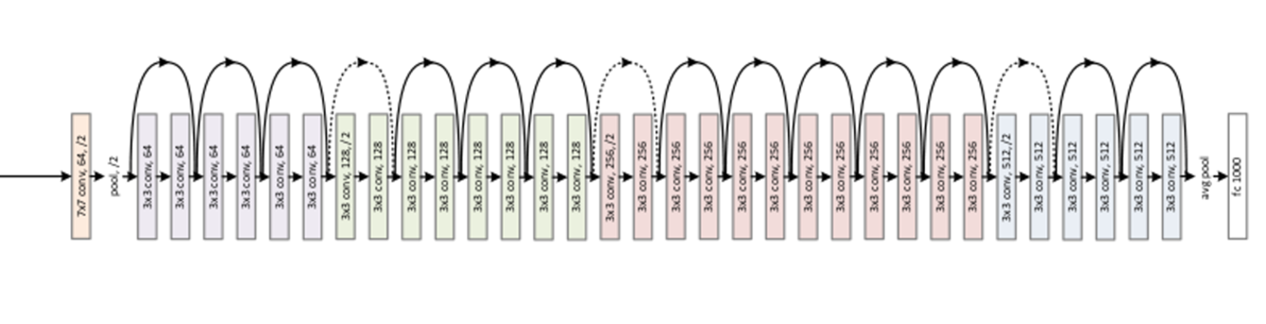
ResNet-34 Architecture
Notes:
As our task required counting specific cells from microscopic images, a deep CNN architecture was required, which could accurately map images to cell count.

Slide 10

ResNet-34 for Cell Counting
ResNet-34 model is originally used for multiclass classification tasks.
But, as we use the model for regression, the output layer of the model, was changed from 1000 cells to 1 cell.
For the regression task, the RMSE Loss function was used.
The model was trained on batches of size 32, for 100 epochs.
Adam optimizer was used, with a learning rate 5e-5.
Notes:
As our task required counting specific cells from microscopic images, a deep CNN architecture was required, which could accurately map images to cell count.

Slide 11
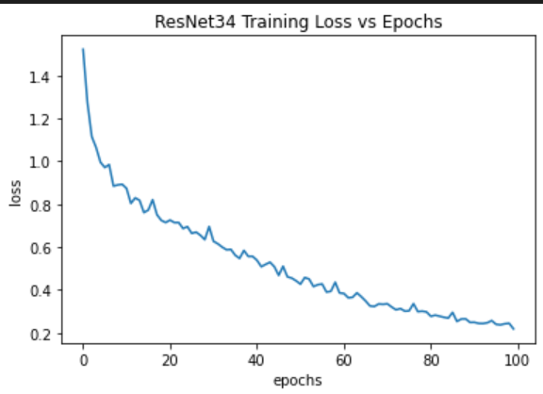
Results
Predictions were made on the test images using the model.
RMSE Score on public leaderboard - 1.15
RMSE Loss on private leaderboard - 0.98
Notes:
As our task required counting specific cells from microscopic images, a deep CNN architecture was required, which could accurately map images to cell count.

Slide 12
Conclusion
Here, we conclude that, even a complex task like counting the number of very specific cells (objects), can be accomplished using Convolutional Neural Networks like ResNet modified for regression.
We can also conclude that, multiclass image classification models, specially ResNets, can also be suited for regression tasks, and their performance can be as commendable as that for classification tasks.
We finally conclude that the ResNet-34 model modified for regression performed a well on the microscopic image data, achieving a good score and low RMSE.
Notes:
As our task required counting specific cells from microscopic images, a deep CNN architecture was required, which could accurately map images to cell count.

Slide 13
THANK YOU!

